Slide 1


SMART INDIA HACKATHON 2024
TITLE PAGE
Problem Statement ID – 1526
Problem Statement Title- Student Innovation
Theme- Smart Education
PS Category- Software
Team ID-
Team Name (Registered on portal)- Quadminds

Slide 2
SMART EDUCATION
Quadminds
Proposed Solution:
AI-powered app that offers personalized study schedules and tracks student progress. Curates high-quality educational content, tailored to each student’s syllabus and learning style. Includes reminders for assignments, exams, and daily study goals.
How It Addresses the Problem:
Solves time management issues by providing a structured timetable and task prioritization. Reduces distractions by filtering content and offering only educational resources. Encourages consistent progress through personalized reminders and tracking.
Innovation and Uniqueness:
Combines AI-driven recommendations with gamified elements like points and badges. Unique focus on distraction-free learning through content curation. Engages students by allowing customization of themes and earning rewards for milestones.

Slide 3
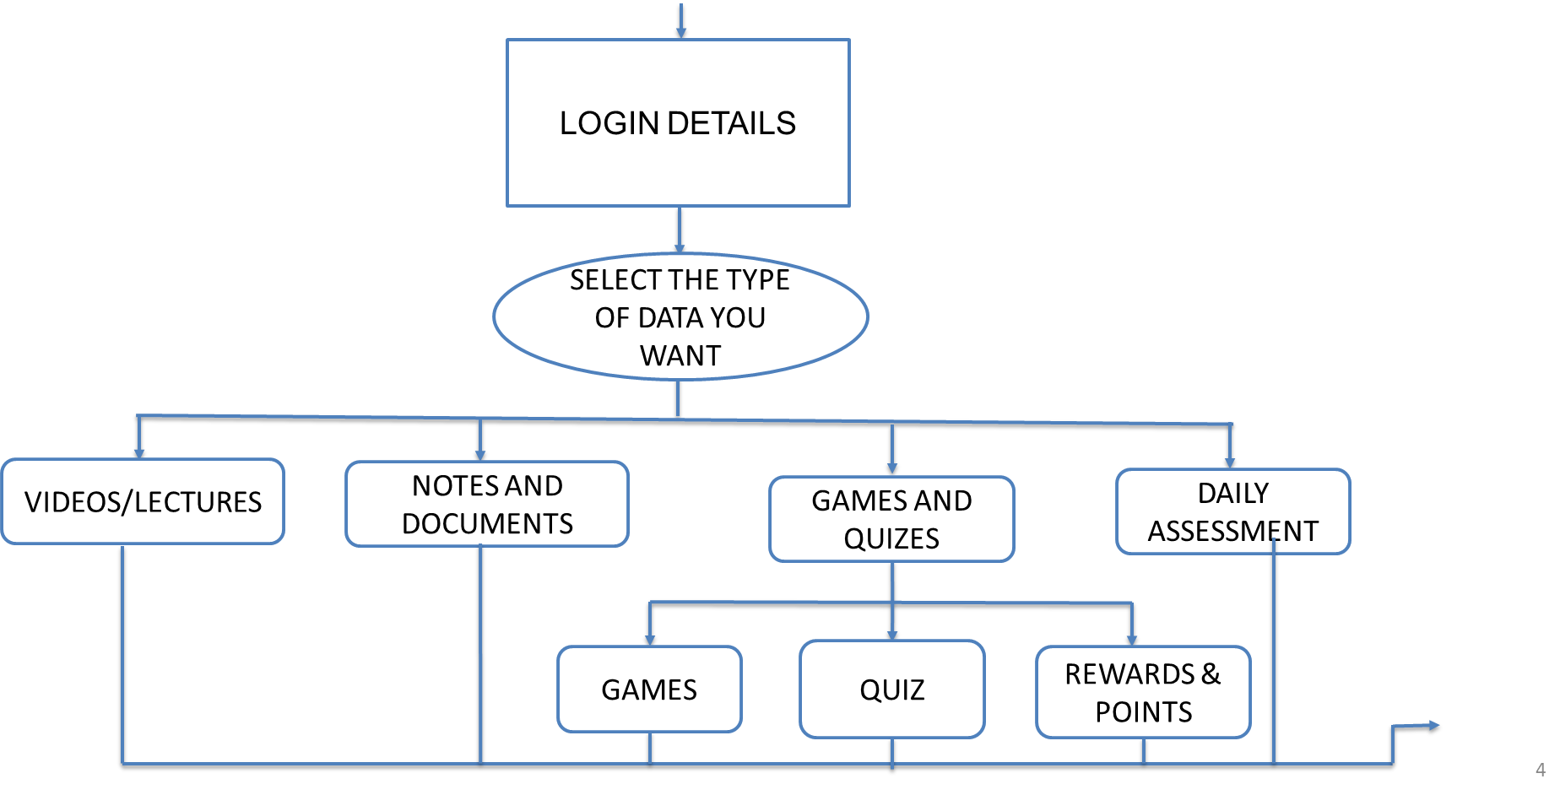






TECHNICAL APPROACH
Quadminds
FRONTEND:
HTML
CSS
ReactJS
BACKEND:
NodeJS
ExpressJS
DATABASE:
MongoDB

Slide 4
FEASIBILITY AND VIABILITY
Quadminds
Feasibility Analysis:
The idea is feasible due to advancements in AI, machine learning, and web development tools, allowing for personalized study plans, content curation, and progress tracking. The concept aligns with modern educational needs for customized, tech-driven learning.
Potential Challenges and Risks:
Data Privacy: Managing sensitive student information.
AI Accuracy: Ensuring reliable and relevant study recommendations
User Engagement: Sustaining student motivation and use over time.
Time-Tracking Consistency: Maintaining accurate tracking across devices.
Strategies for Overcoming Challenges:
Data Security: Use encryption and ensure compliance with data protection laws.
AI Optimization: Regular updates and user feedback to refine algorithms.
Engagement: Introduce gamified rewards and customizable features.
Tracking Accuracy: Implement cross-device syncing and automated checks..

Slide 5
IMPACT AND BENEFITS
Quadminds
Potential Impact on the Target Audience:
Personalized learning plans tailored to individual needs, improving motivation and academic outcomes.
Distraction-free environment with student-only YouTube integration, ensuring focused learning.
Dynamic quizzes & assessments adapted to each student's progress, enhancing exam preparation.
Gamified learning elements like rewards and customizations keep students engaged and motivated.
Real-time academic tracking allows continuous monitoring and adjustments to study plans for optimal progress.
Benefits of the Solution:
Provides personalized support, fostering student confidence and creating a more inclusive learning environment.
Affordable alternative to traditional tutoring, improving long-term earning potential by enhancing educational outcomes.
Promotes better time management, self-discipline, and adaptive learning, ensuring students stay on track and succeed in exams.

Slide 6
RESEARCH AND REFERENCES
Quadminds
https://developer.mozilla.org/en-US/docs/Web
https://spring.io/guides/gs/spring-boot/
https://study.com/academy/lesson/what-is-gamification-in-education-definition-research-strategies.html
https://uwaterloo.ca/centre-for-teaching-excellence/catalogs/tip-sheets/gamification-and-game-based-learning
https://axios-http.com/
Description: Smart Education, a concept that describes learning in digital age. It enables learner to learn more efficiently, effectively, flexibly and comfortably

